Slide 1
Karate Hands-On
Björn Beskow

Slide 2
Agenda
Kort recap
Setup av miljö
Beskrivning av System Under Test
API testing: basics
Test Doubles: Stubs and Mocks
Java Interoperability: Databaser och Testdata
Java Interoperability: JMS köer
Performance Testing (Gatling)
UI Test Automation

Slide 3
Karate (a.k.a karate-dsl)
Created by Peter Thomas @ Intuit
Open Source Software, released Feb 2017
Currently in version 1.4.0
Built in Java with Nashorn Javascript engine
BDD style, Gherkin syntax (Cucumber)
Maintained by Karate Labs, who provides Karate IDE plugins
Originally for API testing, but has grown over the years

Slide 4
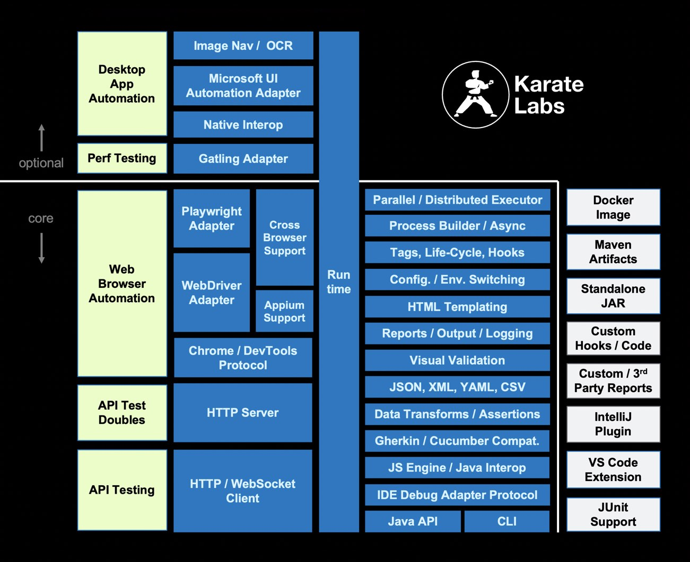

Slide 5
Karate vs Cucumber
Scenario: create product
Given url product_url
And request {sku: "sku1"}
When method post
Then status 201
And match response.sku == "sku1"
... and that’s it!
Scenario: create product
Given product endpoint is up
And request where sku is 'sku1'
When we send post request
Then status is 201
And returned JSON with sku 'sku1'
+ step definitions
+ pojos
+ validation code

Slide 6
Karate vs Rest Assured
Scenario: create product
Given url product_url
And request {sku: "sku1"}
When method post
Then status 201
And match response.sku == "sku1"
public void testCreateProduct() {
given()
.body("{\"sku\":\"sku1\"}")
when()
.post(product_url)
.then()
.statusCode(201)
.body("sku", equalTo("sku1"))
}

Slide 7
Karate Key Selling points
Easy to read Gherkin syntax with good IDE support
Native Data Formats: json, xml, csv, …
Powerful assertions with fuzzy matching
Full access to Javascript functionality
Full Java Interoperability
Structuring mechanisms for readability and reuse
Powerful reporting
Multi-threaded Parallel execution
JUnit and TestNG integration for automation
Gatling integration for Performance and Load testing

Slide 8
Supported Gherkin Keywords
Feature
Scenario
Given, When, Then, And (or *)
Background
Scenario Outline
Examples

Slide 9
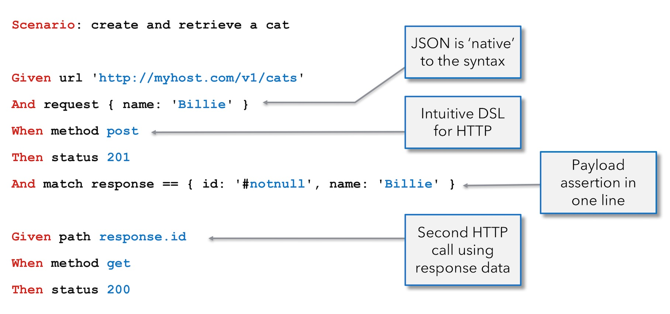
Example Rest Scenario

Slide 10
Core Keywords
url
path
request
method
status

Slide 11
Special variables
response (or short-cut `$`)
responseBytes
responseCookies
responseHeaders
responseStatus (use keyword status)
responseTime
responseType

Slide 12
Configure Workshop Environment
git clone https://github.com/callistaenterprise/karate-workshop.git
Add a row in /etc/hosts: echo '127.0.0.1 host.docker.internal' | sudo tee -a /etc/hosts
Run mvn install -Pdocker in karate-workshop folder

Slide 13
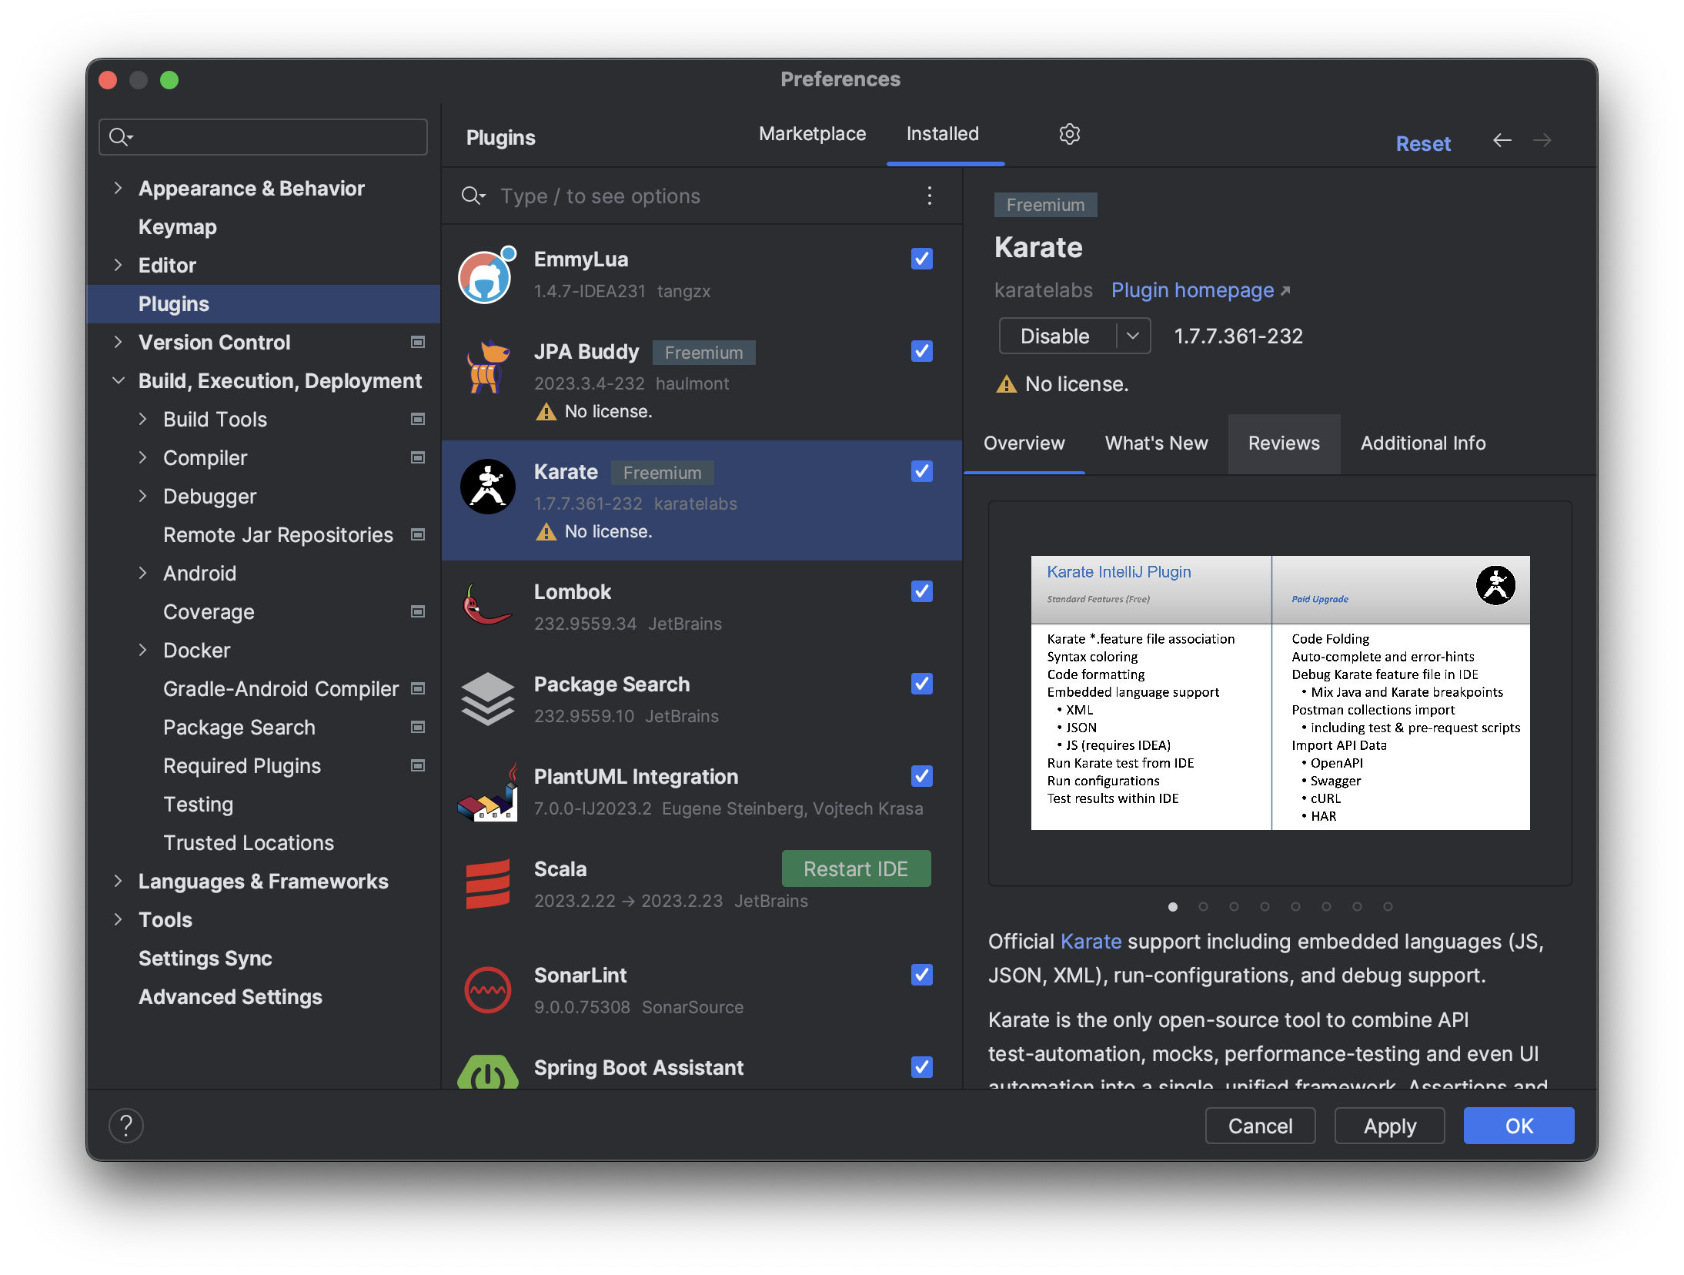
IntelliJ
Installera pluginen ‘Karate’

Slide 14
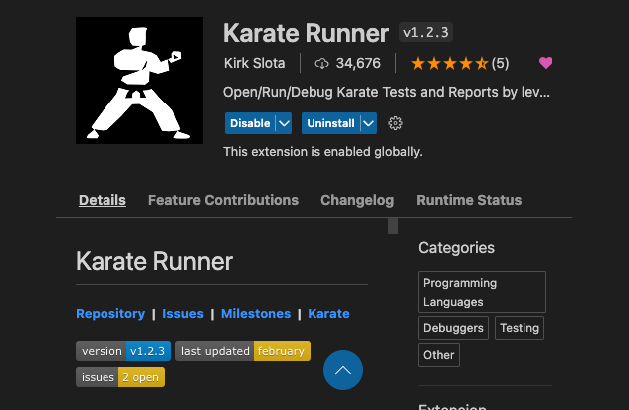
VS Code
Installera extensionen “Karate Runner”

Slide 15
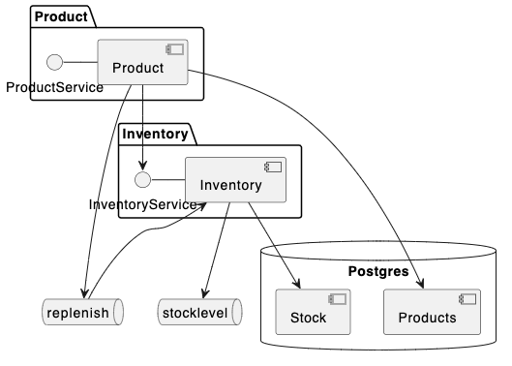
Demo System

Slide 16
Excercise 0
Start the demo system with docker-compose in the system-tests folder: system-tests> docker compose up -d
Run the initial system test: system-tests> mvn test
Open the system-tests folder in VS Code, navigate to System.feature in src/test/java and run the get non-existing product scenario.

Slide 17
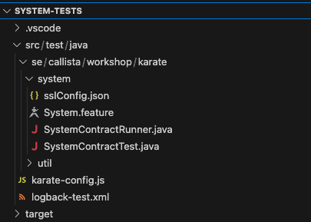
Layout of a Karate project
Toplevel Folder
Externalized Configuration
Gherkin FeatUre
Junit Wrappers
Global configuration
Test logging configuration

Slide 18
Excercise 1
Implement the Scenario: get existing product
Hint: use match response == or match response.name == to verify the payload
Run the test Scenario
Run the test Feature (running both test Scenarios
Navigate to the karate-summary.html test report in target/karate-reports. Open the test report in a browser.

Slide 19
Solution 1
Scenario: get existing product
Given url product_url
And path '/products/sku1’
When method get
Then status 200
And match response.name == {"productId":1,"name":"Product 1","sku":"sku1","inventory":1}
git stash –m "exercise1”
git checkout solution1

Slide 20
Fuzzy Matching
Use JSONPath or XPath to navigate payload
Use built-in fuzzy matching markers:
Expected datatypes: #string, #number, #boolean, #array, #object
Presence of the value: #present, #notpresent
Value is null or not null: #null, #notnull
Regex can be used for string: #regex STR
Array validation: #[Num] EXPR
String value to conform to the UUID format: #uuid
Ignore or skip comparison of a key despite its value is available: #ignore

Slide 21
Excercise 2
Modify the Scenario: get existing product to use fuzzy validation:
Verify that name is correct
Verify that inventory is a number

Slide 22
Solution 2
Scenario: get existing product
Given url product_url
And path '/products/sku1’
When method get
Then status 200
And match response.name == "Product 1”
And match response.inventory == '#number'
git stash –m "exercise2"
git checkout solution2

Slide 23
Using Variables and Javascript functions
The def keyword can be used to define variables (as well as the string, json, xml and xmlstring keywords) : def sku = 'sku1'
The right-hand side of the assignment can be arbitrary javascript : def upperCaseSku = 'sku1'.toUpperCase()
Custom Javascript functions can be defined and assigned to variables: def sleep = function(pause){java.lang.Thread.sleep(pause)}
Global variables and Javascript functions can be defined in karate-config.js:
var config = {
product_url: 'https://host.docker.internal:8443’,
sleep: function(pause) { java.lang.Thread.sleep(pause) }
}

Slide 24
Reading Files
The read keyword can be used to read content (test data, javascript functions or even embedded features) from files on disk or from the classpath: And match response == read('response/new.json’) { "productId":#number, "name":"a new product", "sku":"new", "inventory":0 }

Slide 25
Exercise 3
Implement Scenario: create product
Hints:
verify the response of post
match the response against the content of a test data file
Verify that the product exists, using a get
match against the same test data file
Verify that an inventory item has been created after 2 seconds, using a get for inventory_url at path '/inventory/new’
Use the sleep(<millis>) function to wait
Clean up the test data using a delete on inventory_url at path '/inventory/new’

Slide 26
Solution 3
Scenario: create product
Given url product_url
And path '/products/’
And request {"name": "a new product", "sku": "new"}
When method post
Then status 201
And match response == read('response/new.json’)
Given url product_url
And path '/products/new’
When method get
Then status 200
And match response == read('response/new.json’)
* sleep(2000)

Slide 27
Solution 3 Continued
Given url inventory_url
And path '/inventory/new’
When method get
Then status 200
And match response == {"sku": "new", "stock": 0}
Given url product_url
And path '/products/new’
When method delete
Then status 204
git stash –m "exercise3"
git checkout solution3

Slide 28
Junit Integration: Alternative 1
import com.intuit.karate.junit5.Karate;
class SystemContractRunner {
@Karate.Test
Karate testSystem() {
return Karate
.run("System")
.relativeTo(getClass());
}
}

Slide 29
Junit Integration: Alternative 2
class SystemContractTest {
@Test
void testSystem() {
Results results = Runner
.path("classpath:se/callista/workshop/karate/system")
.parallel(1);
assertEquals(0, results.getFailCount(), results.getErrorMessages());
}
}

Slide 30
Exercise 4
Run the tests using SystemContractRunner and SystemContractTest

Slide 31
When Things Go Wrong
log Request and Response <logger name="com.intuit.karate" level="DEBUG"/>
Print value(s) * print 'response value\n', response
rtfm https://karatelabs.github.io/karate/
STO https://stackoverflow.com/questions/tagged/karate
Source Code https://github.com/karatelabs/karate/tree/master/karate-demo

Slide 32
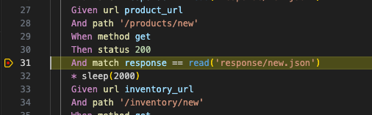
Exercise 5
Add a print statement in Scenario: create product and inspect the result, both in the console and in the test report
Set a break point in Scenario: create product and run the scenario with the debugger
Inspect variables
Run a print command in the Debug Console

Slide 33
Java InteroperabilitY
Access to the Java eco-system is given by the Javascrip tJava.type() function: * def DatabaseAccess = Java.type('se.callista.workshop.karate.util.jdbc.DatabaseAccess’); * def product_db: new DatabaseAccess( 'jdbc:postgresql://host.docker.internal:5432/product', 'admin', 'secret')
Java classes and objects can be used from arbitrary Javascript: Scenario: get existing product * product_db.insertInto('product’, {"id":101,"name":"Product 101","sku":"sku101"})
Java classes can be used from dependencies, or defined inside the Karate test project

Slide 34
Exercise 6
Modify Scenario: get existing product to populate its own test data using the DatabaseAccess utility class from the util/jdbc package, which is instantiated in karate-config.js as product_db
Hint: use the insertInto() method in product_db. Use an id > 100.
Configure an afterScenario Javascript function to clean the test data after each scenario
Configure the function in the Background: section using configure afterScenario = read('...’)
Use the update() method in product_db to issue the SQL statement 'delete from product where id > 100’
Modify Scenario: create product to manage its own test data

Slide 35
Solution 6 Continued
Background:
* configure ssl = read('sslConfig.json’)
* configure afterScenario = read('afterScenario.js’)
function() {
product_db.update('delete from product where id > 100')
}

Slide 36
Solution 6 Continued
Scenario: get existing product
* product_db.insertInto('product’, {"id":101,"name":"Product 101","sku":"sku101"})
Given url product_url
And path '/products/sku101’
When method get
Then status 200
And match response.name == "Product 101"
And match response.inventory == '#number'

Slide 37
Solution 6 Continued
Scenario: deleteProduct
* product_db.insertInto('product’, {"id":101,"name":"Product 101","sku":"sku101"})
Given url product_url
And path '/products/sku101’
When method delete
Then status 204
git stash –m "exercise6"
git checkout solution6

Slide 38
Finishing the System tests
Shut down the demo system with docker compose in the system-tests folder: system-tests> docker compose down

Slide 39
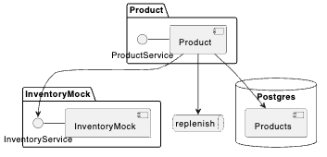
Component tests
Testing a Component in isolation
Replacing any collaborators with Test Doubles

Slide 40
Test Doubles
Karate provides excellent support for implementing light-weight but powerful stateful Stubs and Mocks
Same syntax as test Features, but with different semantics:
Each Scenario describes a specific behaviour of the Mock
Stateful behaviour such as storing interaction state can be implemented as necessary

Slide 41
Test Doubles Example
Feature: Inventory Mock Scenario: pathMatches('/inventory/{sku}') * string requestBody = (request) * def sku = pathParams.sku * def response = read('response/inventory.json')
Scenario: pathMatches('/inventory') * …

Slide 42
Variable or Expression Extrapolation
Embedded expressions inside files can be used to define templates: * def response = read('response/inventory.json’) { "sku" : "#(sku)", "stock" : 1 }

Slide 43
Start Collaborators viA TestContainers
class ProductContractTest { @BeforeAll static void startContainers() { activemq.start(); postgresql.start(); inventoryMock.start(); product.start(); }
@Container private static final PostgresqlTestContainer postgresql = PostgresqlTestContainer.getInstance("postgres:latest", 5432, "admin", "secret", "product");

Slide 44
Exercise 7
Open the product/component-tests project in VS Code
Run the tests via ProductContractTest

Slide 45
Reusing Functions and Features
* configure afterScenario = read('requestRecorder.js')
* def mockUrl = 'http://' + mock_host + ':' + mock_port * def getMockRequests = read('classpath:/mock/getRequests.js')

Slide 46
getRequests.feature
@ignore @report=false Feature: Mock reset feature to be used in an 'afterScenario' hook Scenario: # Get mock requests Given url mockUrl + '/requests' When method get

Slide 47
Exercise 8
InventoryMock records incoming calls, to support Mock behaviour.
The endpoint /requests returns an array of requests in JSON format, containing e.g. uri and body
The getMockRequests() function (defined in karate-config.js) returns the recorded requests
Extend Scenario: get existing product to validate that the Inventory mock has been called once with the correct uri.
Hint: Use def to define a variable to store the recorded requests
Hint: Use '#[1]’ to match length of array

Slide 48
Solution 8
Given def mockRequests = getMockRequests(inventory_mock_url)
Then match mockRequests == '#[1]’
And match mockRequests[0].uri == '/inventory/sku101'
git stash –m "exercise8"
git checkout solution8

Slide 49
Exercise 9
Modify Scenario: create product to messages published to the queue using the QueueListener utility class from the util/jms package, which is instantiated in karate-config.js as replenish_queue
Hint: use the waitForMessage() and size() methods in replenish_queue.
A message with stock = 0 should be published for created products
A message with stock = -1 should be published for deleted products

Slide 50
Solution 9
Scenario: deleteProduct
* product_db.insertInto('product’,
{"id":101,"name":"Product 101","sku":"sku101"})
Given path '/products/sku101’
When method delete
Then status 204
Given json message = replenish_queue.waitForMessage()
Then match message == {"sku":"sku101","stock":-1}
And assert replenish_queue.size() == 1
git stash –m "exercise9"
git checkout solution9

Slide 51
Karate with Gatling
class ProductSimulation extends Simulation { val protocol = karateProtocol() protocol.nameResolver = (req, ctx) => req.getHeader("karate-name") protocol.runner.karateEnv("performance") val productScenario = scenario("Karate Product Scenario") .exec(karateFeature( "classpath:se/callista/workshop/karate/product/product.feature@performance") ) setUp( productScenario.inject(rampUsers(100).during(10)) .protocols(protocol) ) }

Slide 52
Exercise 10
Add the tag @performance on the Get Product scenarios, and make it robust for multithreaded use
Hint: Remove test data population and mock validation
Modify to Karate log level in logback-test.xml to "warn"
Make sure the component under test (including its collaborators) are running using docker-compose in the component-tests folder: docker compose up -d
Run the Gatling simulation using mvn clean test –Pperformance
Inspect the gatling simulation report

Slide 53
Solution 10
@performance
Scenario: get existing product
Given path '/products/sku1’
When method get
Then status 200
And match response.name == "Product 1"
And match response.inventory == '#number'
git stash –m "exercise10"
git checkout solution10

Slide 54
Thank You!

